Slide 1
EARTH OBSERVATION TOOLS TO SUPPORT AGRICULTURE INSURANCE PROGRAM DESIGN & CERTIFICATION
Dr. –Ing. Benson Kenduiywo
RCMRD

Slide 2
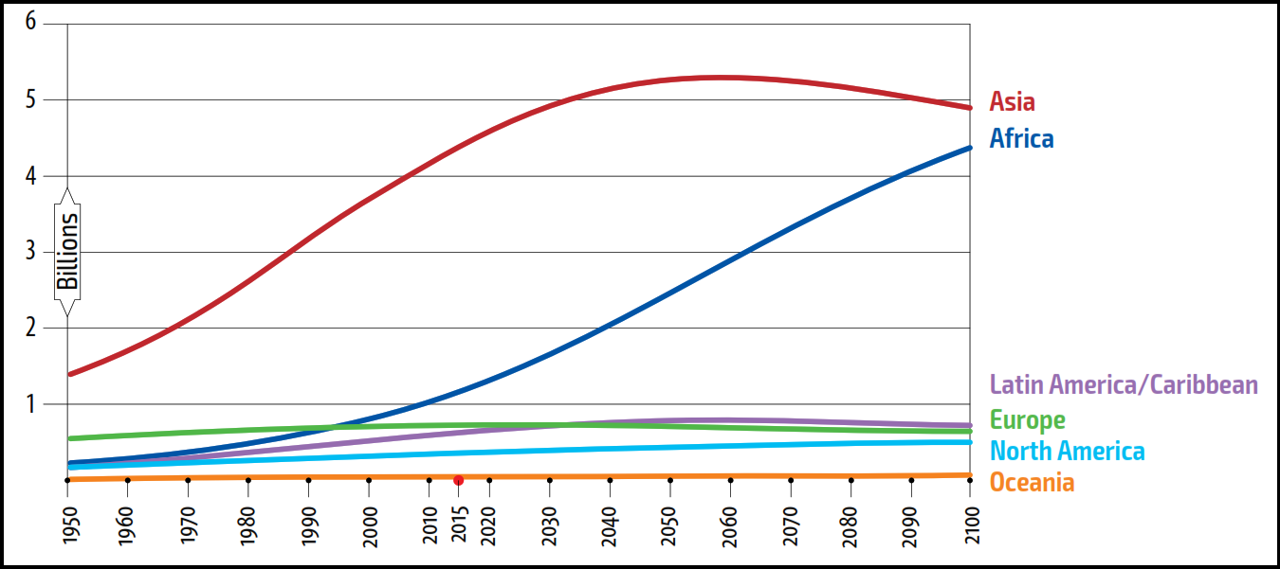
Background
Africa’s population is projected to reach 2B by 2030 & 4.5B by 2100.
Demand for food will increase.
Investments required to end hunger global by 2030 is US$265B a year.
Agriculture index insurance is one tool.
Index insurance: quantifies compensation using EO proxy measures (e.g. NDVI, average zone yields etc).
  Cuts costs (no assessor required, low admin costs)
  Eliminates moral hazard (the incentive of farmers to report losses to get a payout)
  Adverse selection (risk of insuring high risk farmers)
However, index insurance suffers from basis risk: Quality checks needed.

Slide 3
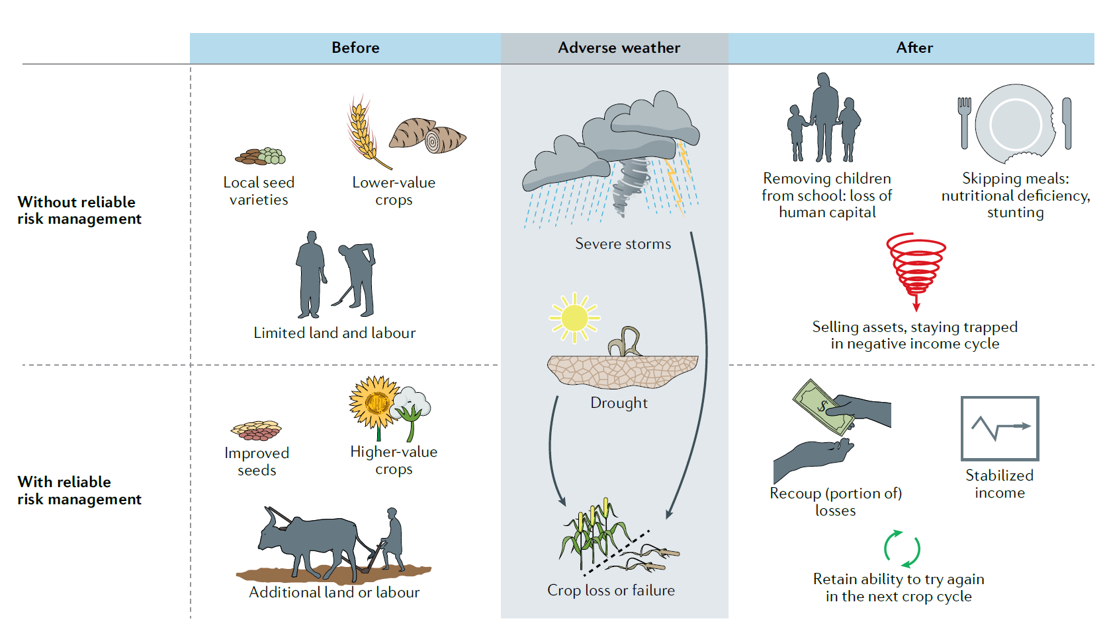
To insure or not?
Good index insurance shields farmers & boosts production.
Allow Governments to invest in products that accelerate & protect economic growth.
Certification is key to ensure contracts meets famers & insurer’s welfare.

Slide 4
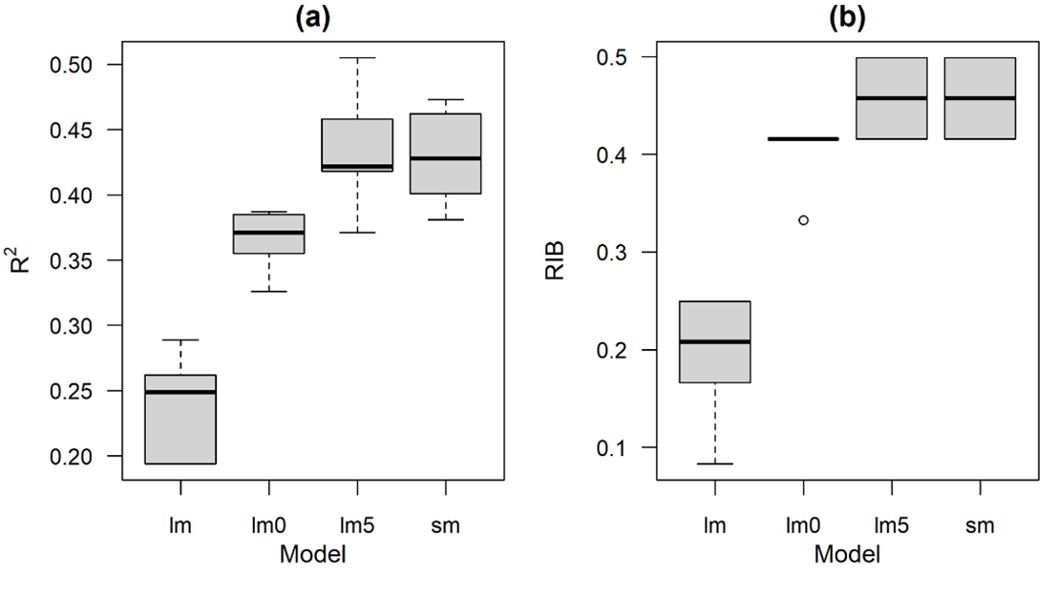
Minimum Quality Standard (MQS)
We introduce a Relative Insurance Benefit (RIB) tool to help certify contracts.
The RIB measures ranges between 0 – 1.
It expresses the welfare benefits of an insurance contract relative to a hypothetical contract that uses a perfect index without error (RIB=1).
It builds on a simple economic framework that allows evaluation of insurance programs benefit.
For instance, derived benefit from an EO index payouts can be compare to real observed incomes during those events.
Different models can be used.

Slide 5
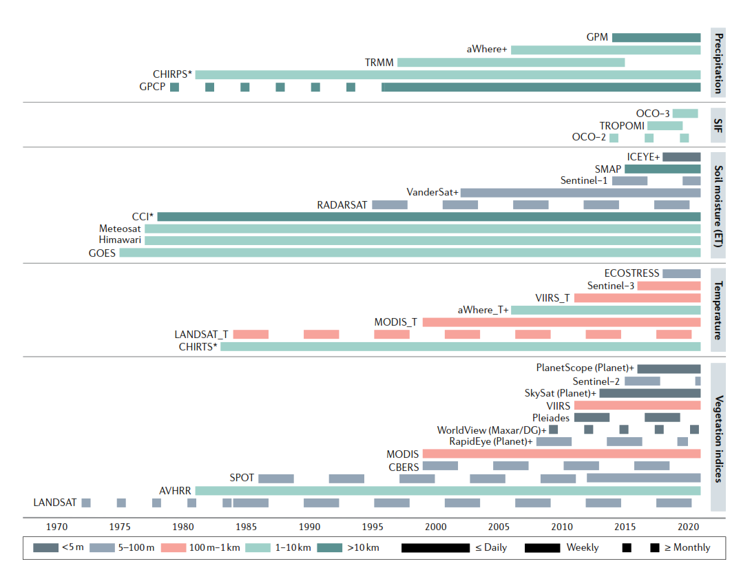
Examples of EO data useful for: Agriculture monitoring
  Source Benami et al (2021)
  SIF: Solar Induced Florence

Slide 6
Findings
Sample Contract: Quality of a hypothetical index insurance contract based on the segmented (sm) regression model with LMD data (R2 of 0.47 and RIB of 0.5) for 8 years and 15 sub-locations in Marsabit, Kenya (points).
  True Negatives: No payment due and none paid;
  Severe False Negatives: contract underpays by more than 30%;
  Intermediate False Negatives: contract underpays between 10% and 30%;
  Small False Negative: contract underpays less than 10%,
  False Positives: contract overpays.

Slide 7
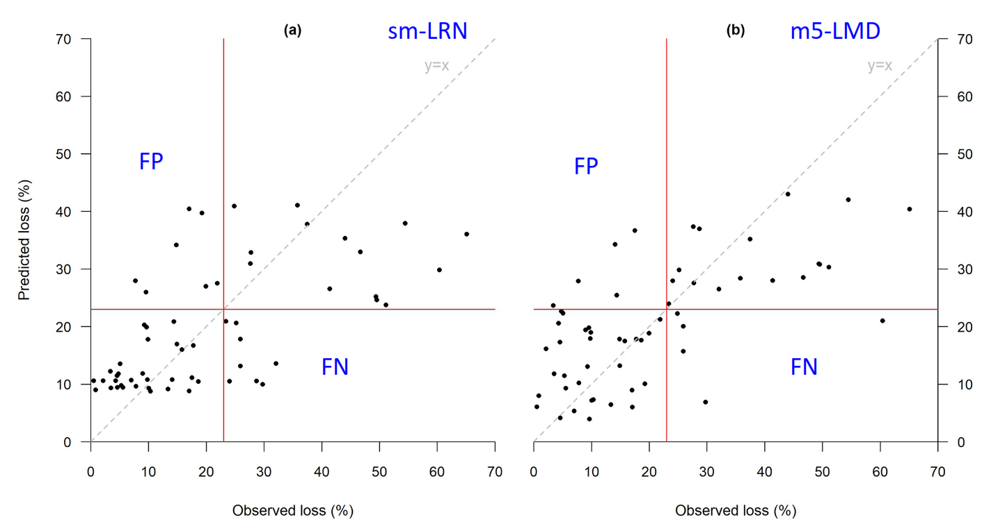
Outcomes
High model quality ≠ high insurance benefit.
Better welfare is determined by a model’s ability to predict well worse conditions.
RIB values of up to 0.5 indicates 50% insurance benefit.
There’s still room to improve RS methods to support insurance.

Slide 8
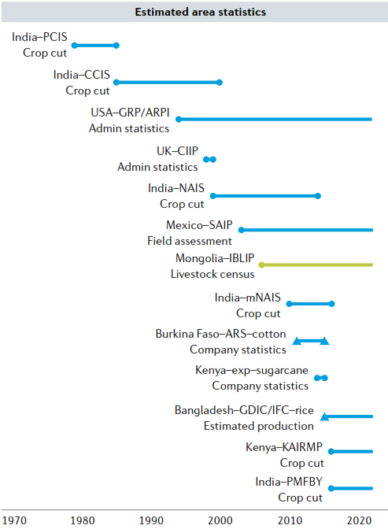
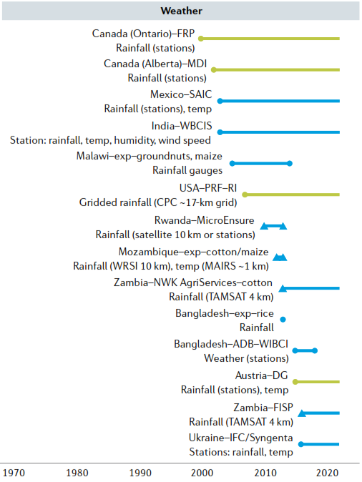
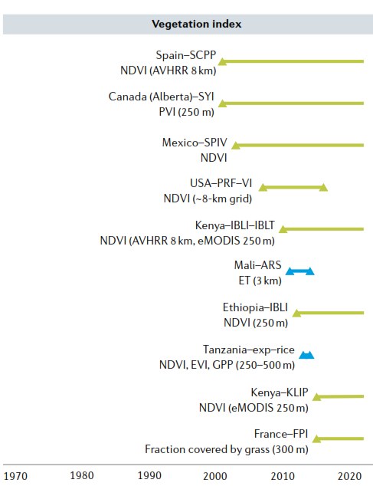
Application area/Experiments
  Source Benami et al (2021)

Slide 9
Collaborators, Stakeholders and Users
Government Ministries of Agriculture.
Insurance Companies
RCMRD
Insurance Regulatory Authorities
Resource/Tools: https://reagro.org/cases/insurance/index.html
https://github.com/reagro/agro
The tool will enhance use of EO to enhance food security.

Slide 10


Acknowledgement
Benson Kenduiywo, Micheal Ross Carter, & Robert Hijmans
Co-Author²
(1) RCMRD SERVIR E&SA, Kenya.
(2) University of California Davis, USA.
Contacts: bkenduiywo@rcmrd.org, rhijmans@ucdavis.edu, and mrcarter@ucdavis.edu

Slide 11


